Slide 1
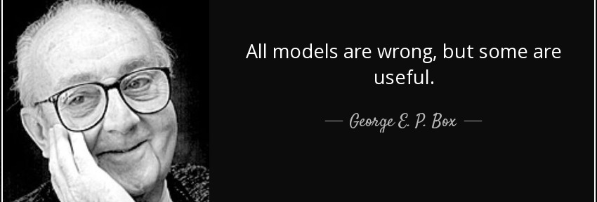
Database Design
The DB schema is a model of reality that captures the information we need for our purposes.
We don’t need to recreate reality, we just need to represent it accurately enough.

Slide 2
Activity – DB Basics
Try to model a library!
Step 1: What entities are there?
People, books, rentals, etc…
Step 2: How are these things related?
E.g. a book can be sent out on a rental.
Step 3: Think about how many things are in each relationship.
E.g. one book can only go in one rental, a rental can have multiple books.
Step 4: What are the attributes for each entity?
E.g. a book has a title, author, identifying number…
Step 5: What are the keys?
E.g. a library patron has a unique ID number.

Slide 3
5.6 Appendix: Fundamentals of Relational Database Operations
Query Languages: search for information in databases or data warehouses
Normalization: optimize the tables in a relational database
Joins: link relational database tables with common attributes

Slide 4
QUERY LANGUAGES: SQL (Structured Query Language)
Typical key words include:
SELECT – what to locate
FROM – specify the source files
WHERE – provides conditions for the search, like an “if” statement
For example, these statements could be combined as follows:
SELECT Student_Name
FROM Student_Database
WHERE GPA>=3.40 and GPA<3.60

Slide 5
QUERY LANGUAGES: QBE (Query by Example)
Uses a form (template) to provide a sample or description of the desired information
Drag and drop features of DBMS such as Microsoft Access enable easy completion of QBE forms

Slide 6
ENTITY-RELATIONSHIP (E-R) MODELING
Database designers plan the database design in a process called entity-relationship (ER) modeling.
ER diagrams consists of entities, attributes and relationships organized using business rules.
Business rules describe how the organization uses its data to run its operations
Entities are shown as rectangles, with relationships shown on the lines between them

Slide 7
E-R Modeling Terms
Degree of relationship: how many linkages?
Unary: single entity
Binary: two related entities
Ternary: three related entities
Relationship classifications (connectivity)
One-to-one (1:1): e.g. student : parking permit
One-to-many (1:M): e.g. professor : class
Many-to-man (M:M) e.g. students : classes

Slide 8
E-R Modeling Terms (Continued)
Cardinality: the number of times a single record/instance of one entity can be associated with a single record/instance of another entity:
Mandatory single: e.g. inventory quantity on hand with its sale price
Optional single: e.g. employee wage rate with pay cheque (employees may not be paid if they are on vacation or leave)
Mandatory many: e.g. department details with employee details
Optional many: customer details with customer sales details/invoices (not all customers purchase every month)
Figures 5A.1 through 5A.4 illustrate these terms

Slide 9
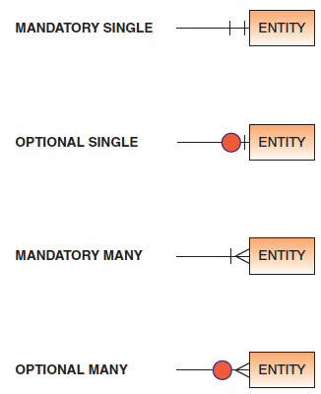
Fig. 5A.1 Cardinality Symbols, p. 142

Slide 10
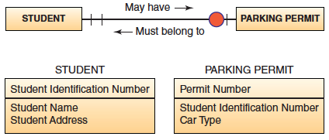
Fig. 5A.2 One-to-one relationship, p. 143

Slide 11
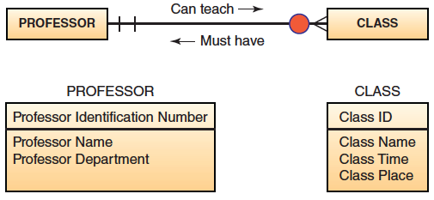
Fig. 5A.3 One-to-many relationship, p. 143

Slide 12
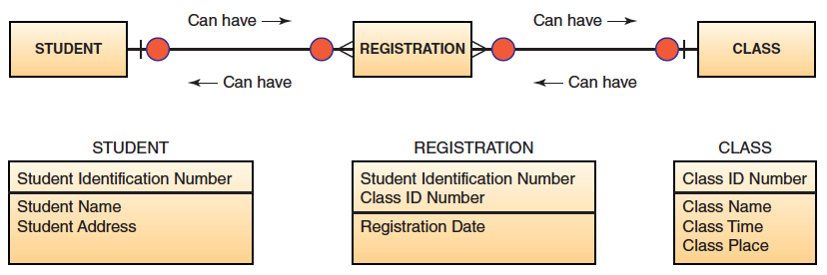
Fig. 5A.4 Many-to-many relationships, p. 143

Slide 13
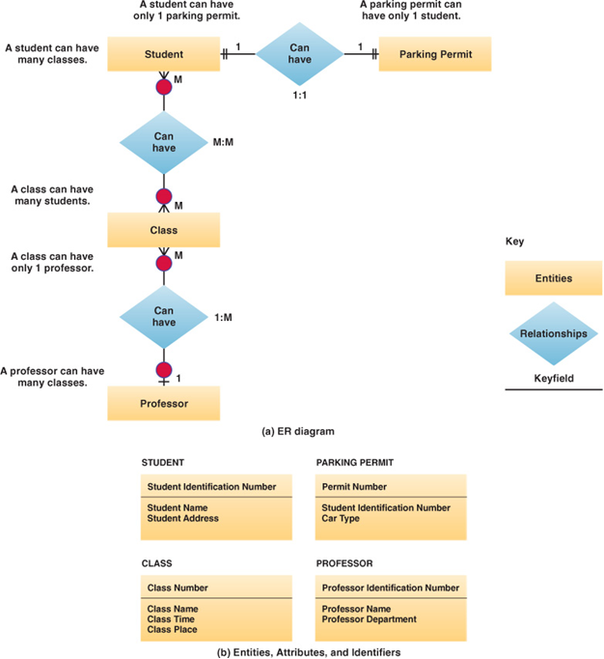
E-R Diagram Model

Slide 14
NORMALIZATION
A method for analyzing and reducing a relational database to its most streamlined form
Purpose is to provide minimum redundancy (minimize duplicated attributes)
Focus is to reduce non-key attributes
Improves processing efficiency of the database
Functional dependencies express how attributes are associated (e.g. every pizza order needs a date) and need to be retained during normalization
Figures 5A.5 through 5A.9 show how normalization would be achieved for a pizza order database

Slide 15
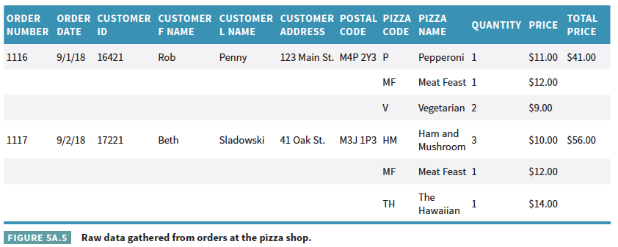
Fig. 5A.5 Raw data gathered from orders at a pizza shop, p. 144

Slide 16
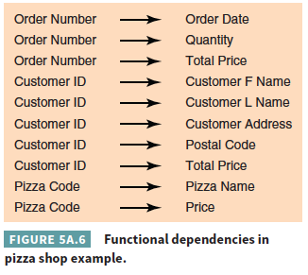
Fig. 5A.6 Functional dependencies in a pizza shop example, p. 145

Slide 17
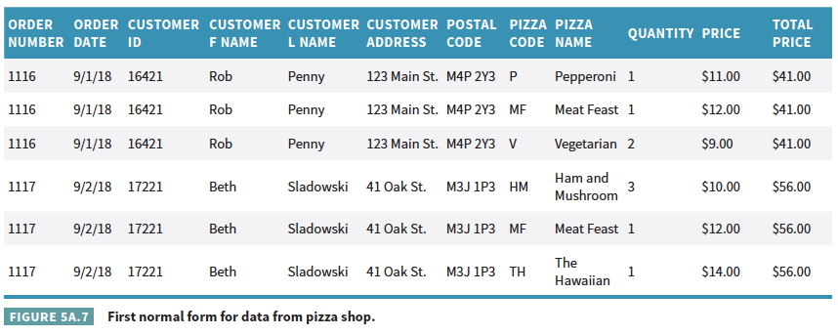
Fig. 5A.7 First normal form for data from a pizza shop, p. 145

Slide 18
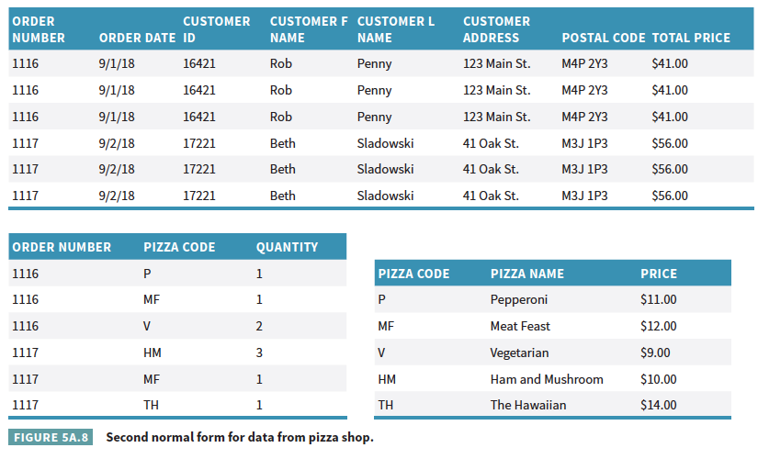
Fig. 5A.8 Second normal form for data from a pizza shop, p. 146

Slide 19
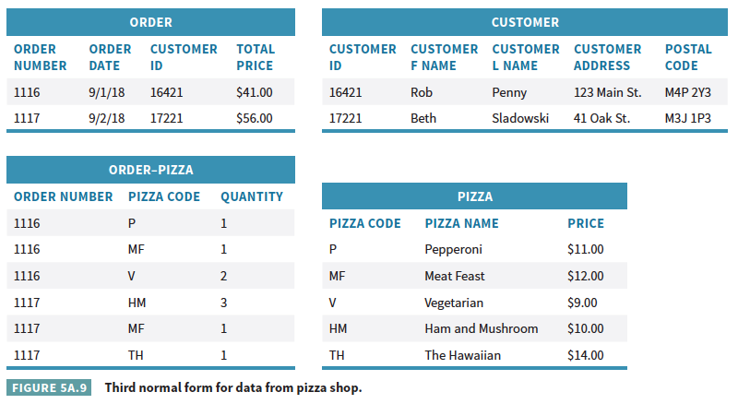
Fig. 5A.9 Third normal form for data from a pizza shop, p. 145

Slide 20
NORMALIZATION (CONTINUED)
The third normalized form shows that
There is no data redundancy
Foreign keys are used to link tables

Slide 21
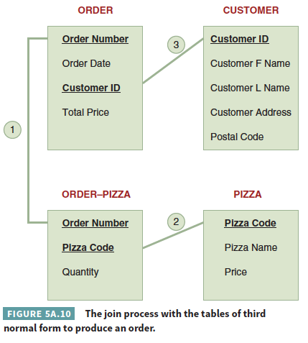
JOIN: Combines records from two or more tables, Fig. 5A.10, p. 147

Slide 22
https://www.sql-practice.com/
All patient names and birthdays from Ontario.
All data from patients without allergies.
All patients, along with their diagnosis.
Patient names, diagnoses, and province NAME.
List of admissions where people stayed more than a day.

